Slide 1
Practice session: Multiple linear regression
Advanced Statistics
Ilham Fadhil N. & Santi Novani

Slide 2
Multiple linear regression
Assumption check
Linear model
Assess the model fit
Adjustment of the model and data transformation

Slide 3
Setup
#install packages corrplot untuk membuat tabel korelasi dan packages car untuk mengambil data yang akan digunakan
>install.packages("corrplot")
>install.packages(“car”)
#mengaktifkan packages agar dapat digunakan >library(car)
>library(corrplot)
>library(moments)
>library(e1071)

Slide 4
Check for Assumption
Normality
Graphical analysis
Kurtosis and skewness
Kolmogorov-smirnov test
Heteroscedasticity
Graphical analysis
Breush-pagan test
Multicollinearity
Residual analysis
VIF
Linearity
Residual analysis
Graphical analysis

Slide 5
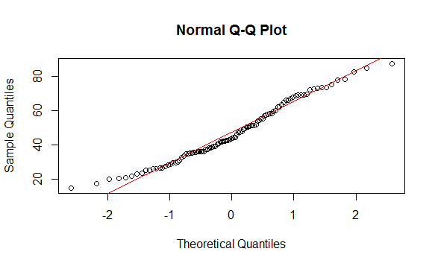
Normality
QQ-Plot
#membuat QQ plot secara 2 tahap. Pertama membuat titik, kemudian membuat garis seharusnya jika data itu normal
> qqnorm(x)
> qqline(x, col = "red")
Semakin mendekati garis merah, maka distribusi data nya mendekati distribusi normal

Slide 6


Normality
Graphical analysis
Box plot
boxplot(x, xlab = " ", ylab = " ",main = " ", col = " ")
Histogram
hist(x, xlab = " ", main = " ", col = " ")
Kurtosis
kurtosis(x, type = 2)
Calculate the z kurtosis
Compare it with critical point
Skewness
skewness(x, type = 2)
Calculate the z skewness
Compare it with critical point

Slide 7

Normality
Skewness and Kurtosis critical points:
$Z_{skew}(prestige)=\frac{S − 0}{\sqrt{\frac{6}{n}}}=\frac{0.3386}{\sqrt{\frac{6}{100}}}=1.3823$
$Z_{kur}\left(prestige\right)=\frac{K − 0}{\sqrt{\frac{24}{n}}}=\frac{−0.7255}{\sqrt{\frac{24}{100}}}=−1.4809$
If alpha = 0.01, then the critical point is +- 2.58.
If alpha = 0.05, then the critical point is +- 1.96.

Slide 8

Normality
Kolmogoronov-smirnov test
ks.test(x, "pnorm", mean(x), sd(x))
If the p-value > 0.05, the data is normally distributed

Slide 9
Add dataset
#untuk mengecek sekilas data
>head(Prestige, 5)
#melihat struktur data yang ada pada data prestige >str(Prestige)
>summary(Prestige)
#mengambil data dari prestige kolom 1 sampai 4, kemudian buat data frame bernama newdata
>newdata <- Prestige[,c(1:4)]
>summary(newdata)

Slide 10
Examine data
#membuat plot matrix antar variabel
>plot(newdata, pch = 16, col = "blue", main = "Matrix Scatterplot of Income, Education, Women, and Prestige")

Slide 11
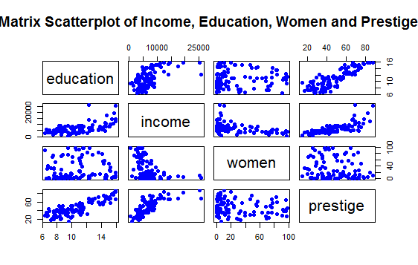

Slide 12
Prestige data
Education refers to the average number of years of education that exists in each profession.
The women variable refers to the percentage of women in the profession
The prestige variable refers to a prestige score for each occupation (given by a metric called Pineo-Porter), from a social survey conducted in the mid-1960s in Canada.
$$Income=B_{0}+B_{1}∙Education+ B_{2}∙Prestige+B_{3}∙Women$$

Slide 13
Examine the relationship among variables
Income and education variable relationship
Income seemed increase as number of years in education increase
Income and women variable relationship
Income seemed decrease as percentage women in profession increase
Income and prestige variable relationship
Income seemed increase as prestige increase

Slide 14
Linear Model
Function:
>lm(y ~ x1 + x2 + x3, data = data)
#membuat linear model dan melihat hasilnya
>mod1 <- lm(income ~ education + prestige + women, data=newdata)
>summary(mod1)

Slide 15
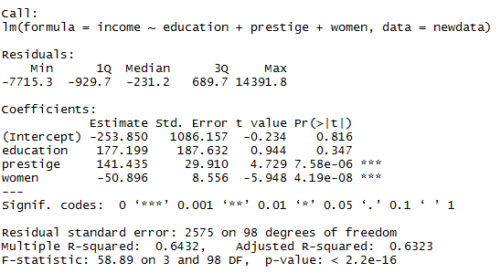
Result

Slide 16
Result interpretation
Coefficient-standard error
The coefficient Standard Error measures the average amount that the coefficient estimates vary from the actual average value of our response variable
Coefficient - t value:
a measure of how many standard deviations the coefficient estimate is far away from 0
Coefficient - Pr(>t):
the probability of observing any value equal or larger than t
Associated ‘signif. codes’: Three stars (or asterisks) represent a highly significant p-value, there is a strong relationship between predictor- and response variables
Residual standard error:
a measure of the quality of a linear regression fit
the number of data in the final calculation of a statistic that are free to vary (example 98 of 102 data)
R-squared: (0 – 1)
a measure of how well the model is fitting the actual data
a measure of the linear relationship between predictor variable and response variable

Slide 17
Result interpretation
F-statistic:
a good indicator of whether there is a relationship between predictor and the response variables
The further the F-statistic is from 1 the better it is.

Slide 18
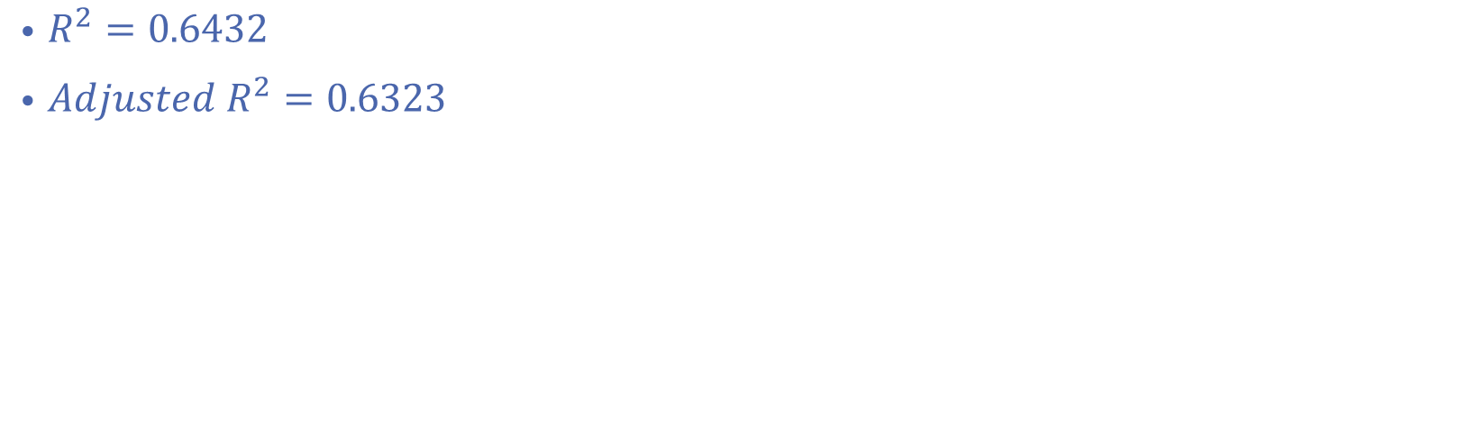
Result model
$$Income=(−253.850)+117.199 Education+141.435 Prestige−50.896 Women$$
$R^{2}=0.6432$
$Adjusted R^{2}=0.6323$

Slide 19
Refine data
# Center predictors.
>education.c <- scale(newdata$education, center=TRUE, scale=FALSE)
>prestige.c <- scale(newdata$prestige, center=TRUE, scale=FALSE)
>women.c <- scale(newdata$women, center=TRUE, scale=FALSE)
# bind these new variables into newdata and display a summary.
>new.c.vars <- cbind(education.c, prestige.c, women.c)
>newdata <- cbind(newdata, new.c.vars)
>names(newdata)[5:7] <- c("education.c", "prestige.c", "women.c" )
>summary(newdata)

Slide 20
Correlation table
# Membuat correlation graph
>newdatacor <- cor(newdata[1:4])
>corrplot(newdatacor, method = "number")

Slide 21
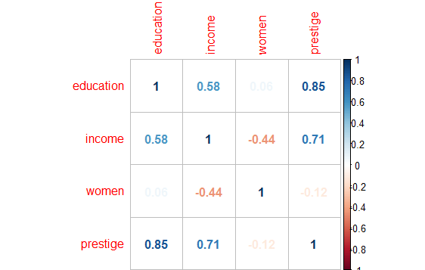

Slide 22
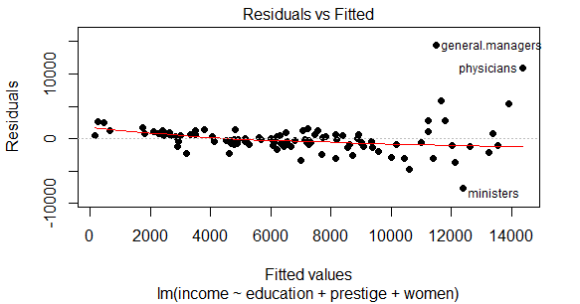
Result plot
# Plot model residuals.
>plot(mod1, pch=16, which=1)

Slide 23
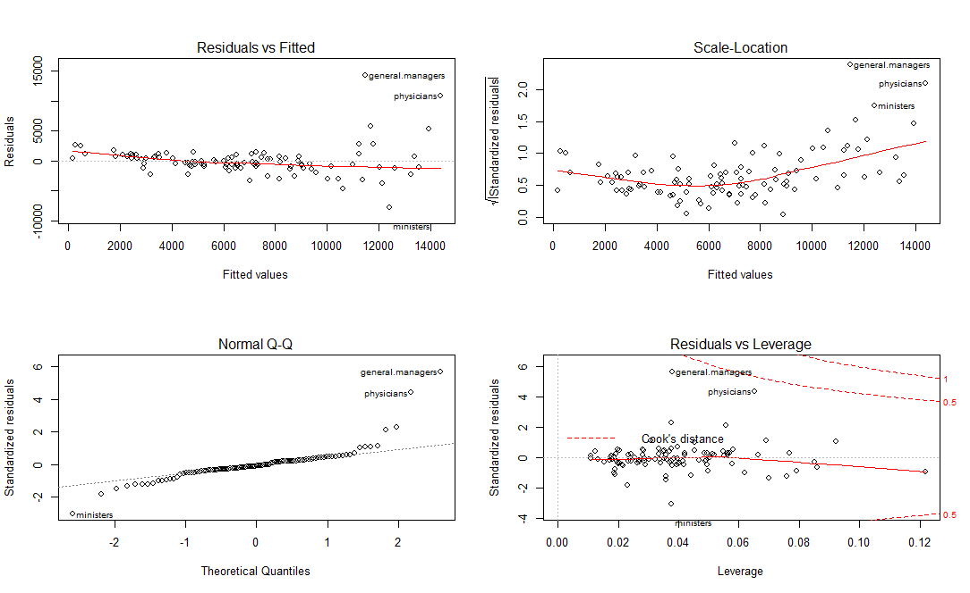

Slide 24

Heteroscedasticity
Graphical analysis : if there is no heteroscedasticity, you should see completely random, equal distribution of points throughout the range of X axis and a flat red line
Residual vs Fitted Plot
Scale – location Plot
Breusch – Pagan test
bptest(mod1)
If the p-value is less than 0.05 infer there is heteroscedasticity present in the residuals

Slide 25
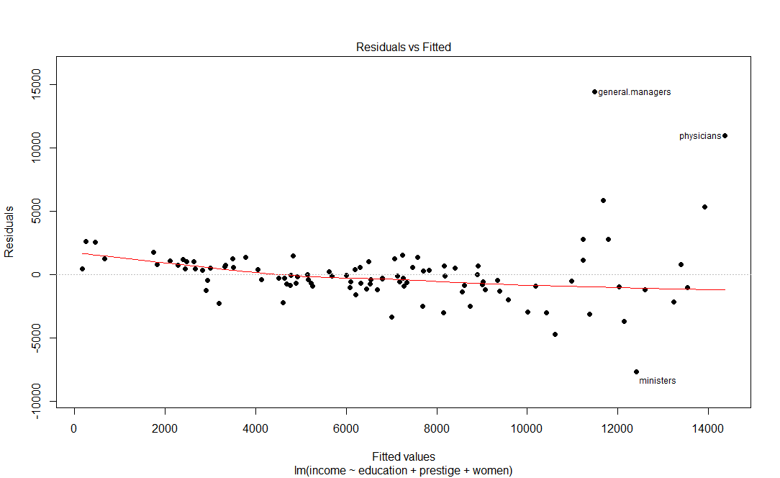
Linearity
Graphical analysis
Residual vs Fitted

Slide 26

Multicollinearity
Variance Inflation Factor (VIF)
Lower the VIF is better for the model, but mostly the cut off value for VIF is 10

Slide 27
Fin

Slide 28
Prestige Data
The Prestige data frame has 102 rows and 6 columns:
education
Average education of occupational incumbents, years, in 1971.
income
Average income of incumbents, dollars, in 1971.
women
Percentage of incumbents who are women.
prestige
Pineo-Porter (socioeconomic status (SES) estimation) prestige score for occupation, from a social survey conducted in the mid-1960s.
census
Canadian Census occupational code.
type
Type of occupation. A factor with levels (note: out of order): bc, Blue Collar; prof, Professional, Managerial, and Technical; wc, White Collar

